Slide 1



New Title
Presented by Steve Stedman

Slide 2
FILESTREAM and FileTables
Presented by Steve Stedman
Twitter: @SqlEmt

Slide 3
About the Speaker/Author (Steve Stedman)
Joes2Pros
Author of the Common Table Expression Book
Instructor at the Joes2Pros Academy
23 Years of database work
Developer of the Database Health Application
http://DatabaseHealth.com
Working at Emergency Reporting as CTO
Twitter: @SqlEmt
Website: http://SteveStedman.com

Slide 4
Benefits coming your way!
FILESTREAM
Introduction and Configuration
TSQL FILESTREAM Access
FileTables
Configuring and Creating FileTables
Insert, Update and Delete with a FileTable
Drag and drop with the file system

Slide 5
FILESTREAM Introduction and Configuration
Section 1

Slide 6


Introduction to FILESTREAM
SQL Server
Notes:
Vivid: Several years ago, I was hired to work on a database to help improve performance. This database had some of the typical performance tuning issues that needed to be addressed, but as I looked into it in more detail I discovered that for a 90gb database, 80gb was used up by one table. Looking further into that table, there was one column of type varbinary that was being used to hold files. After some re-architecting the software that was using the database to store files, I was able to convince the developers that there was a really great system to store files, it is called a file system. What helped convince them of this was the projected costs to upgrade the SQL Server hardware and licensing over the next 3 to 5 years to accommodate these files. It became very clear that at that point in time the file system was the best system to store files.

Slide 7
SQL Server
Notes:
That was then, and times change. Microsoft added new features to SQL Server 2008 called FileStream that is still an important part of SQL Server 2012.
FileStream allows for a VARBINARY(MAX) column to be set to write to a location on disk rather than to the traditional storage location in the SQL Server Database.

Slide 8
SQL Server
Notes:
By using FILESTREAM for large BLOB (Binary Large Objects) data such as varbinary(max) and varchar(max) can be moved from the database to the filesystem allowing for better performance and smaller database files. Imagine a table with 30gb of varbinary(max), without filestream all of that varbinary data might end up in memory cluttering the buffer pool and pushing other data out of memory.
With FILESTREAM you have most the ease of accessing data as thought it was just stored in a column, but you get the performance of saving the files to disk.
Additionally when a backup is run the filestream files are included in the SQL Server backup.

Slide 9
Enabling FILESTREAM
Demo

Slide 10
3 Ways to Enable FILESTREAM
During SQL Server Installation
SQL Server Configuration Manager
Sp_configure

Slide 11
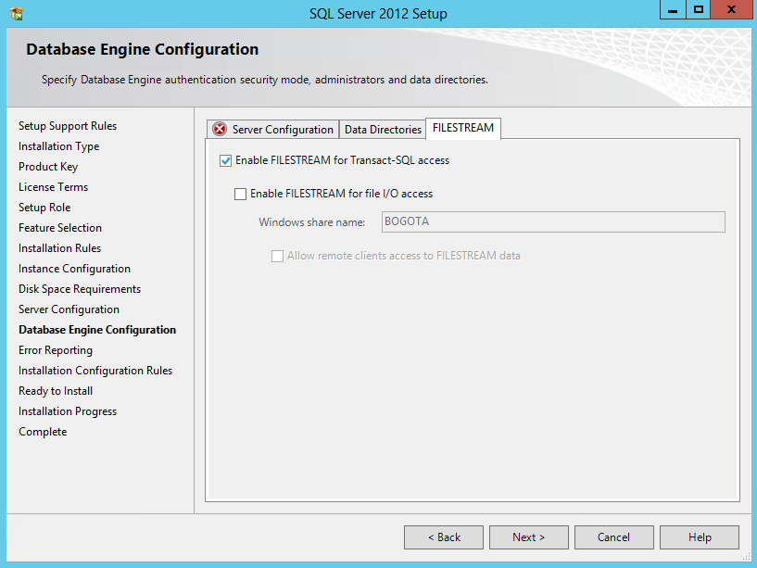
FILESTREAM during SQL Server Installation

Slide 12
Enabling FILESTREAM with sp_configure
There are three levels that can be set with sp_configure for FILESTREAM
0 : FILESTREAM support for the instance is Disabled
1 : FILESTREAM for T-SQL Access is Enabled
2 : FILESTREAM for T-SQL and Windows streaming access is Enabled

Slide 13
FILESTREAM Introduction and Configuration
Demo

Slide 14
TSQL FILESTREAM Access
Section 2

Slide 15
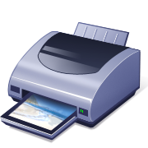

TSQL FILESTREAM Access
Notes:
VIVID: Assume that you just purchased a new printer for your computer, you bring it home and attempt to make it work, but you don’t have the right cables, and it is not a wifi printer. There is no way to print without getting the right cables to connect the printer to your database. You then go back to the store, purchase the right cables, and you are ready to start printing.
Filestream is similar, if you enable your database for filestream, and create a filestream table, you now need the right tools to connect and use that filestream table. Just like how you can print if you have all the right connections, you can use filestream if you have the right query knowledge.

Slide 16
TSQL FILESTREAM Access
JProCo
JProCo Filestream Files
Notes:
FILESTREAM works by storing the varbinary or BLOB (Binary Large Objects) in the file system rather than storing them in the database. The filestream column allows queries to access that data in a similar way that you would access varbinary data that is stored in the database.

Slide 17
TSQL FILESTREAM Access
Demo

Slide 18
Configuring and Creating FileTables
Section 3

Slide 19






Configuring and Creating FileTables
Notes:
Vivid: Assume that you have thousands of pictures that you have taken with your digital camera of the last decade. In this case you may have them organized in any number of directories based on dates, or topics, or some other structure. You probably don’t have a way to tag or label those pictures with anything besides the filename that the digital camera assigned them, or maybe you gave them each a descriptive name to replace the default camera name. If you could organize these in a database you could assign all types of useful information to them like the names of the people in the picture, or the location they were taken.
To achieve this task you may want to store the filenames in the database and then add columns to a table to describe the details associated with those filenames.

Slide 20
FileTable
JProCo
Notes:
FileTables are a database hierarchy attached to all the files in a given directory in your filesystem, allowing standard file system access to all of those files with their existing filenames. Filetable can give you that association from the filesystem structure to a relational database model. When you insert to a filetable it creates the files on disk, and when you add files to the directory on disk it is equivalent to inserting to the table.

Slide 21
FileTable Compared To FILESTREAM
Directory structure configurable.
FileTable has fixed columns.
Windows API compatible allows direct file access from most applications.
Directory structure configured by SQL server using UNIQUEIDENTIFIER.
You control the columns.
Requires specific programming to access files directly.
FileTable
FILESTREAM
Notes:
FileTable has a number of differences from FILESTREAM. Some of these are the following:
FileTable allows for your own directory structure, which can be about any structure you may need, including the existing filenames, but with FILESTREAM the structure on disk is configured by SQL Server, and uses UNIQUEIDENTIFIERs for the file names.
FileTable is a special table that has a fixed set of columns, where filestream can be applied to any NVARCHAR(MAX), VARCHAR(MAX) or VARBINARY(MAX) column in the database.
FileTable files are directly accessible through a network share from almost any application. However notepad and paint that use memory mapped files don’t work with FileTable network shares most other applications doo. To use use files stored in FILESTREAM there must be FILESTREAM specific applications to access the files.

Slide 22
sp_configure filestream_access_level
0 : FILESTREAM support for the instance is Disabled
1 : FILESTREAM for T-SQL Access is Enabled
2 : FILESTREAM for T-SQL and Windows streaming access is Enabled

Slide 23
Configuring and Creating FileTables
Demo

Slide 24
Insert, Update and Delete with a FileTable
Section 4

Slide 26
Insert, Update and Delete with a FileTable
Demo

Slide 27
FileTable Drag and drop with the file system
Section 5

Slide 28
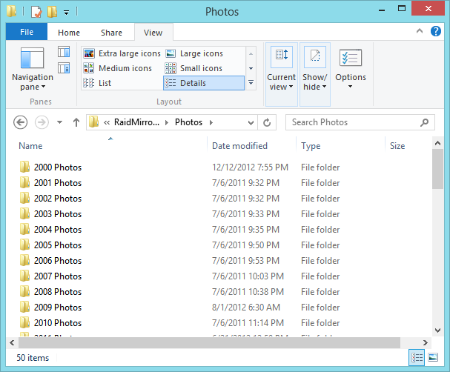
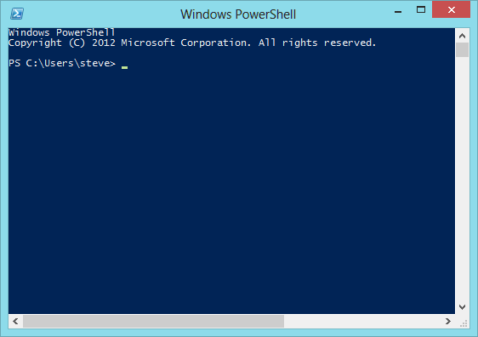
Insert, Update and Deleting from FileTable
Notes:
Vivid: If you are familiar with moving or updating files in the Windows file system you might be more comfortable moving files with the File Explorer or Windows Explorer, but if you are experience with windows command line or Power Shell, that may be more comfortable for you. Either way if you are dragging using the graphic interface, or writing commands to do it through Power Shell you are achieving the same thing.
With FileTables in SQL Server it is similar to this, you can still use the graphical interface of the File Explorer, or you can write commands in T-SQL to do the same thing.

Slide 29
FileTable Drag and drop with the file system
Demo

Slide 30
4. Recursive CTE
Considered recursive when the CTE references itself
Recursion stops
When the recursive query produces no results
Or specify MAXRECURSION
Uses
Hierarchical listing of categories
Recursive calculations
Much, much more…

Slide 31
Chapter 8 – DELETE
DELETE FROM CTE;
Are the following SQL Statements valid?
Can you delete from a CTE?
What does that mean?
;WITH CustomerCTE AS
(
SELECT *
FROM Customer
WHERE LastName like 'Williams'
)
DELETE FROM CustomerCTE;
;WITH CustomerCTE AS
(
SELECT c.*
FROM Customer AS c
INNER JOIN SalesInvoice AS si
ON si.CustomerID = c.CustomerID
WHERE c.LastName like 'Williams'
)
DELETE FROM CustomerCTE;

Slide 32
Alternative to a Numbers Table.
Demo
;WITH Numbers (N) AS
(
SELECT 1
UNION ALL
SELECT 1 + N FROM Numbers
WHERE N < 1000
)
SELECT *
FROM Numbers
OPTION (MAXRECURSION 1000);

Slide 33
More Information
Follow me on Twitter
@SqlEmt
Database Health Project
http://DatabaseHealth.com
Visit my website
http://stevestedman.com
Send me an email:
Steve@SteveStedman.com
Download Slides and Sample TSQL
http://stevestedman.com/speaking/

